Slide 1
Hyper Early Stop
Amay Gada
Notes:
M - data
A - machine learning
O -
D - decoder llm

Slide 2
Problem
Model should predict the accuracy of a DNN model at epoch M, given information till epoch E
Report the accuracies of the eval_acc for the following settings:
(E=5, M=150)
(E=10,M=150)
(E=20, M=150)
(E=30, M=150)
(E=60, M=150)

Slide 3
Data Manipulation
Fix row mismatch
The hyperparameter configuration rows in train_loss.csv and eval_acc.csv don’t match for some records.
I fixed that using hash maps
Remove rows with Nans completely.

Slide 4
Data Manipulation
Averaging loss over a batch stabilizes training by reducing noise from individual sample losses
Considering this, we can average over the 50 minibatches and get a concise train loss per epoch
I averaged over 50 mini batches to get a mean average per epoch in train_loss.csv

Slide 5
Data Manipulation
Combine the manipulated datasets into 1 csv
Convert all hyerparameter values to integer, and losses and accuracies to floats.
Reduce the hyperparameters to be between 0 and 1 (divide by 10) -> To not allow feature overpowering and induce stability
Create train, test and Validation Datasets using partition.txt

Slide 6
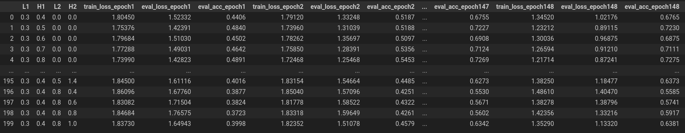
Data Manipulation

Slide 7
Data Manipulation Code
Code: data_manipulation.ipynb
The final data as a result of the manipulations described above is stored in the folder data
Note that the partition.txt had to be slightly modified (due to the mismatch).

Slide 8
Modelling Strategy
The data is a clear time series data
I used 2 stacked layers of LSTM for prediction.
The model size is pretty small because the data we have is very limited
I create a new model for each E value.
Notes:
david

Slide 9
Modelling Strategy
Model input:
vector of (Batch_size, time_steps, 7)
7 because -> 4 hyper parameters + train_loss at epoch_i + eval_loss at epoch_i + eval_acc at epoch_i
(The hyper parameter vector is copied in each timestep as it doesn't change with time)
Output = Eval accuracy at epoch M
Notes:
david

Slide 10
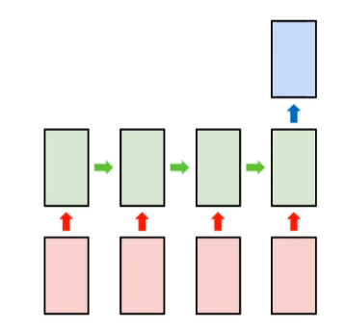
Modelling Intuition
H = Hyperparameter Vector
Dk = Loss/acc information vector at epoch k
Am = Eval accuracy at epoch M
LSTM(<H, k1>, <H,k2>, <H,k3> … <H,kE>) = Am
Notes:
david

Slide 11
Modelling Parameters
Optimizer: ADAM
Loss Function: MSE
Checkpoint: every epoch
Learning rate: depends on E
Num epochs: depends on E
Notes:
david

Slide 12
Modelling Code
Code: model.ipynb
Saved models found at file path ./ckpt/e{value}/model_epoch{epoch_number}.h5
The model.ipynb also has code for generating training graphs and prediction graphs.
Notes:
david

Slide 13
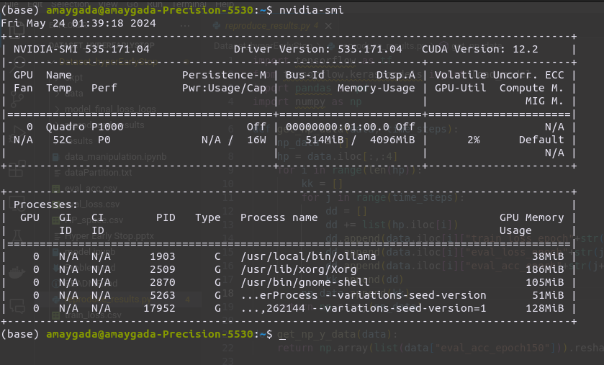
GPU used
Notes:
david

Slide 14
E=5
Notes:
david

Slide 15
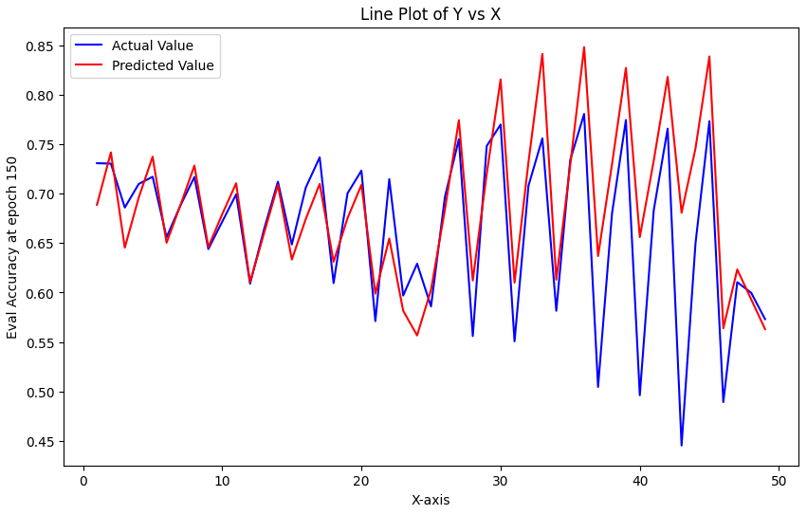
Prediction Plot

Slide 16
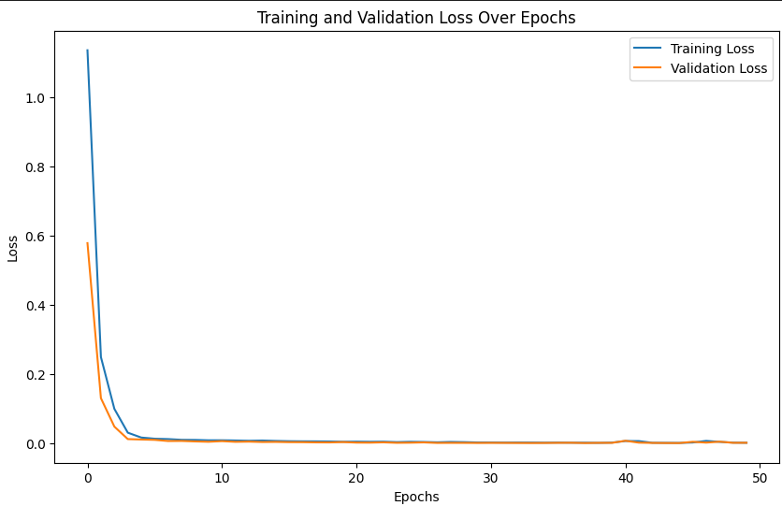
Training plot

Slide 17
E=10
Notes:
david

Slide 18
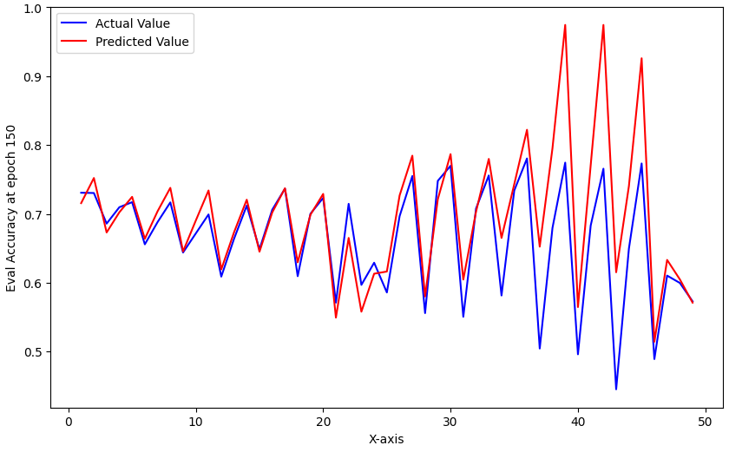
Prediction Plot

Slide 19
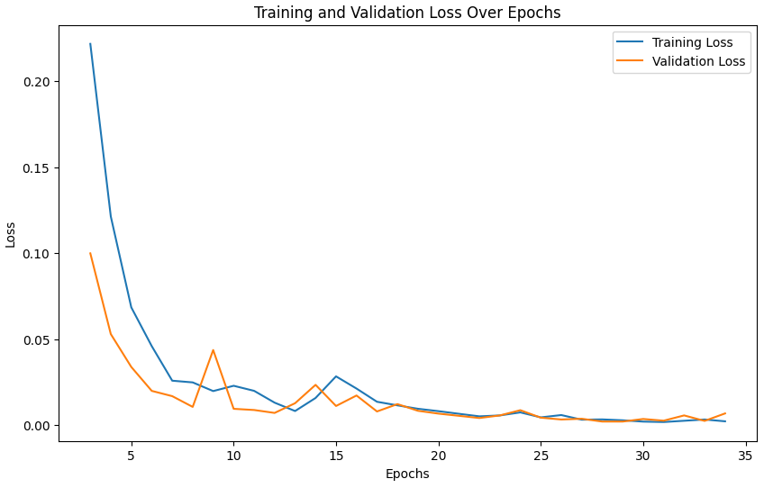
Training plot

Slide 20
E=20
Notes:
david

Slide 21
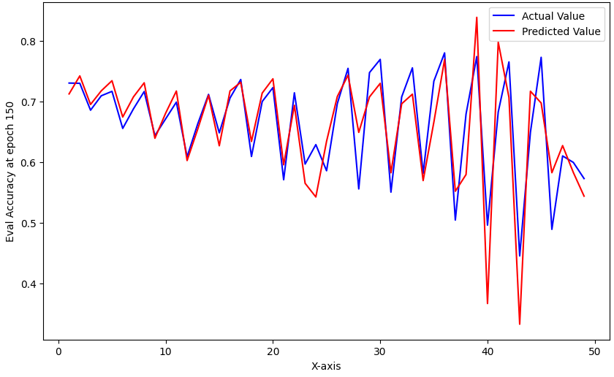
Prediction Plot

Slide 22
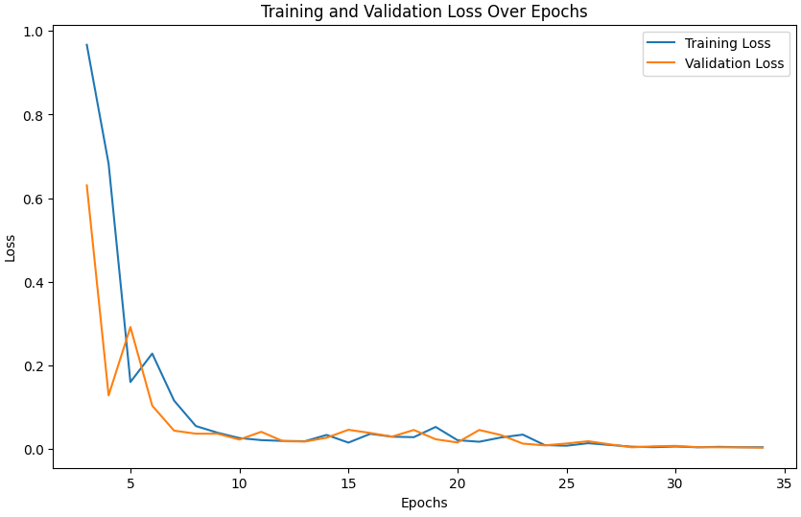
Training plot

Slide 23
E=30
Notes:
david

Slide 24
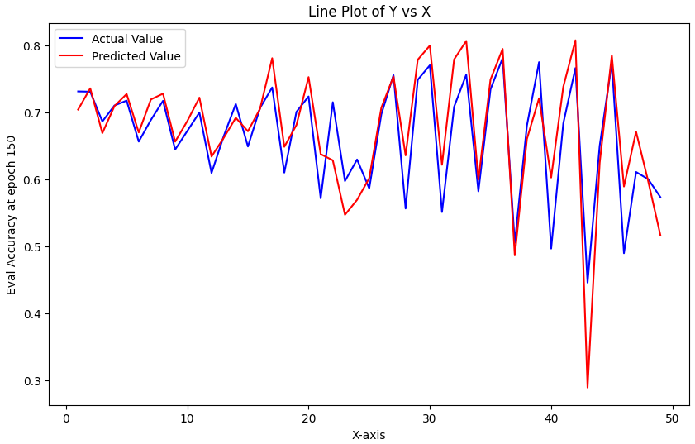
Prediction Plot

Slide 25
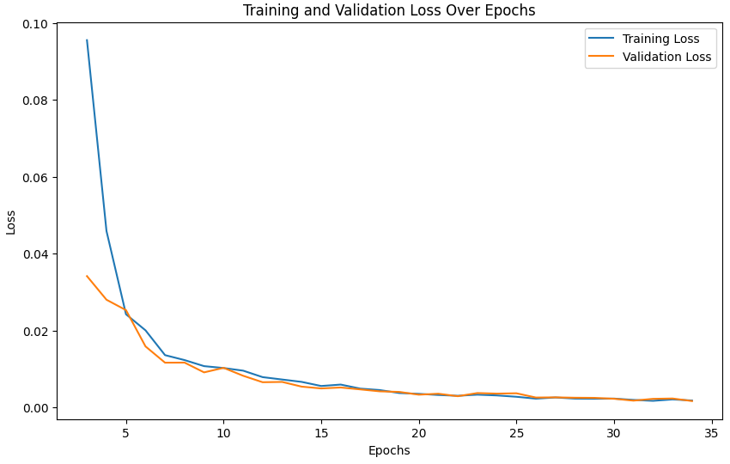
Training plot

Slide 26
E=60
Notes:
david

Slide 27
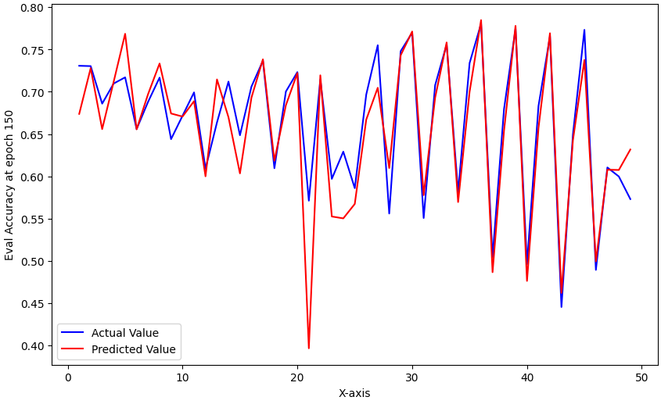
Prediction Plot

Slide 28
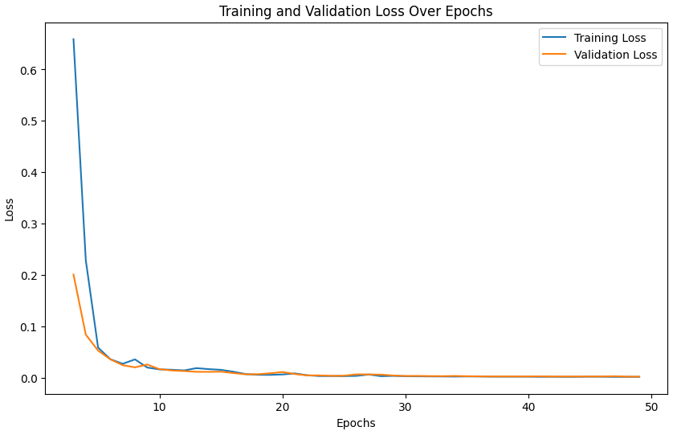
Training plot

Slide 29
Discussion on Tuning
Learning rate
As the history increases from E=5 to E=60, the training time and convergence time varies. The learning rate is tweaked in model.ipynb for each model so that convergence is smooth and fast.
Batch size
8 (it is small because the data is small as well)
Num epochs
Num units in LSTM
Notes:
david

Slide 30
Observations on results
Training curve
The training curve smoothens to a smaller value till it converges along the progressing epochs.
This is expected as we are optimizing on the MSE using an adaptive, momentum based gradient descent algorithm.
The smooth reduction implies successful training
As E increases, the learning rate has to be modified for similar smoother training.
Notes:
david

Slide 31
Observations on results
Prediction plot
As E increases, the predicted values get closer to the actual values
This is expected because the model has more history to train over.
There are some discrepancies at E=10
I believe this is because of small data size and indiscernible patterns
Training time
As E increases, the training time increases as expected
This is because of rise in data size
Notes:
david

Slide 32
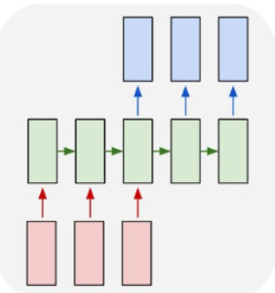
A better approach?
Instead of predicting just M=150, we can predict a vector of eval_accuracies.
Eg. predict accuracies from <M=70 to M=150>
How to do it?
Many to Many LSTM
Why is it better?
We can choose the best accuracy from a predicted vector. We also train fewer models in the process
Notes:
david

Slide 33
A better approach?
I am travelling and through the weekend and hence I am unable to complete this implementation.
I won’t be back in time for the submission deadline.
However, implementing this would not be a huge feat.
Ideas worth exploring
Different models per E
A single model that can take “None” tokens for a dynamic E value.
Notes:
david

Slide 34
A better approach?
It is also worth exploring using pure attention models
Transformers
According to my one of my previous projects on implementing a small transformer from scratch, I have seen that
They are faster
They have better history retention
For such a small data, this might be overkill
Notes:
david

Slide 35
Results
The predicted values for test data as extracted from partition.txt are stored in the folder “./results/e{E value}/result.csv”
Each folder corresponds to an E value
Notes:
david

Slide 36
Reproducing the Results
Pip packages
pip install tensorflow==2.12.0
pip install matplotlib==3.7.1
pip install pandas==1.3.5
pip install numpy==1.22.4
Notes:
david

Slide 37
Reproducing the Results
For training
Go through model.ipynb and run cells under the desired markdown heading
For reproducing prediction results
run "python reproduce_results.py"
The result will print on the screen
The result will also be in the folder ./reproduced_results/e{E value}
Notes:
david

Slide 38
Thank you !

